Slide 1
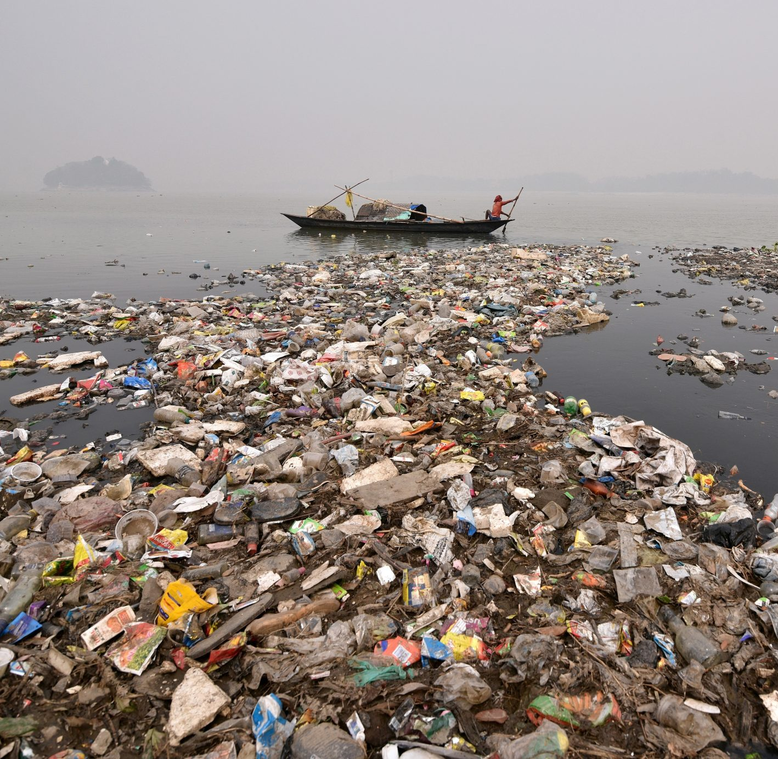

ECOBOT
Challenge selected :
LEVERAGING AI/ML FOR PLASTIC MARINE DEBRIS CHALLENGE
Team Members
Zeinab Essam Eldin Hassan Elgohary
Mostafa Hamdy
Rania Tarek sakr
Ahmed Gomaa Negm
Amr Basha

Slide 2
Describe your challenge
Marine debris is one of the most pervasive threats to the health of coastal areas, oceans, and waterways. Marine debris can injure or kill marine fauna, damage and degrade habitats, cause economic loss to fishing and maritime industries, degrade the quality of life in coastal communities, and threaten human health and safety. It is believed that at least eight million tons of plastic end up in our oceans every year and comprise 80% of all marine debris present—from surface waters down to deep-sea sediments.
Describe your challenge
we developed a solution based on the engineering concept plug and play, though our implementation is missing some parts but every country that wish is to install our system all they have to do follow the details we explained on our main web site. Our solution is based on the SWARM Intelligence that is the collective behavior of decentralized, self-organized systems, natural or artificial. the Kenel of our project is AI/ML model that is capable of detecting quantifying, monitoring and collecting the Marine debris in any costal environment.

Slide 3
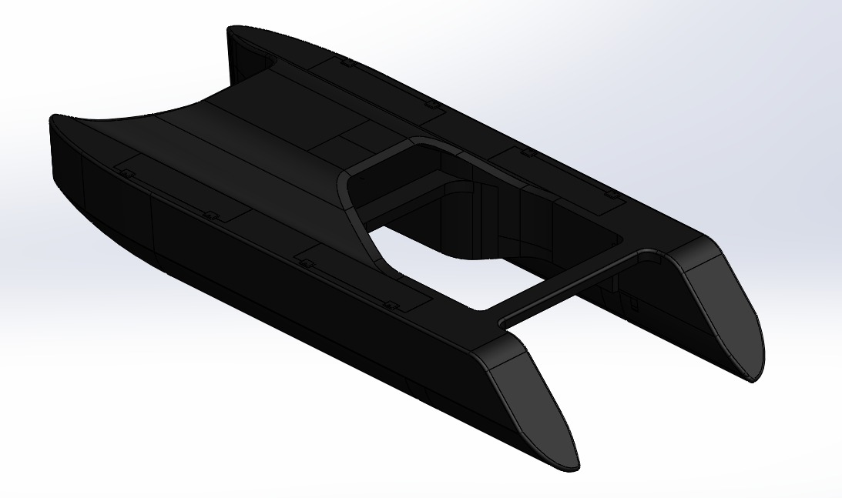
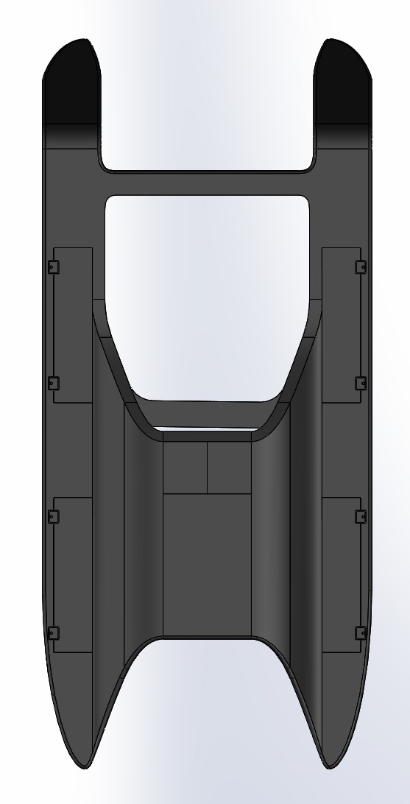
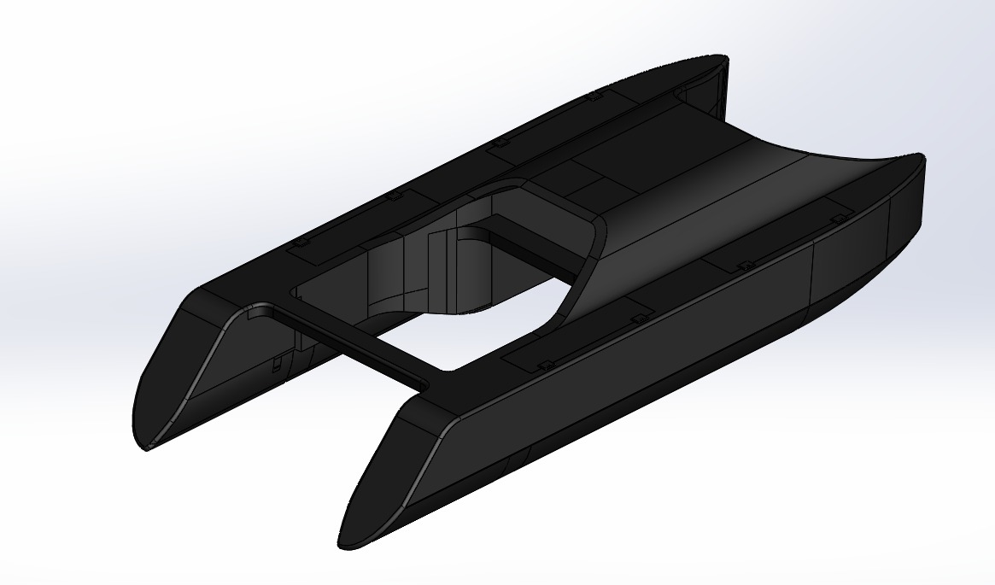
PROTOTYPE
Razer Clear bot Design copy-Rights

Slide 4
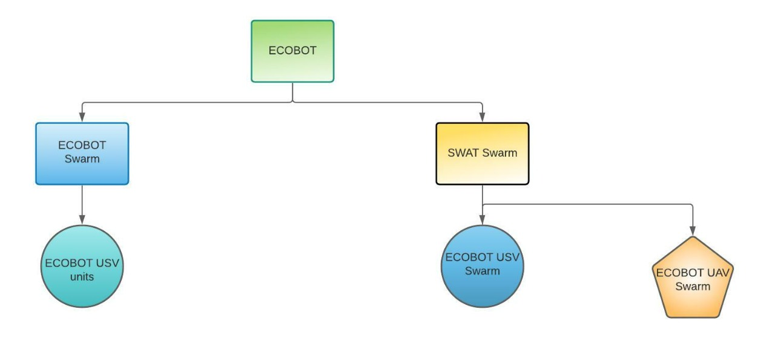
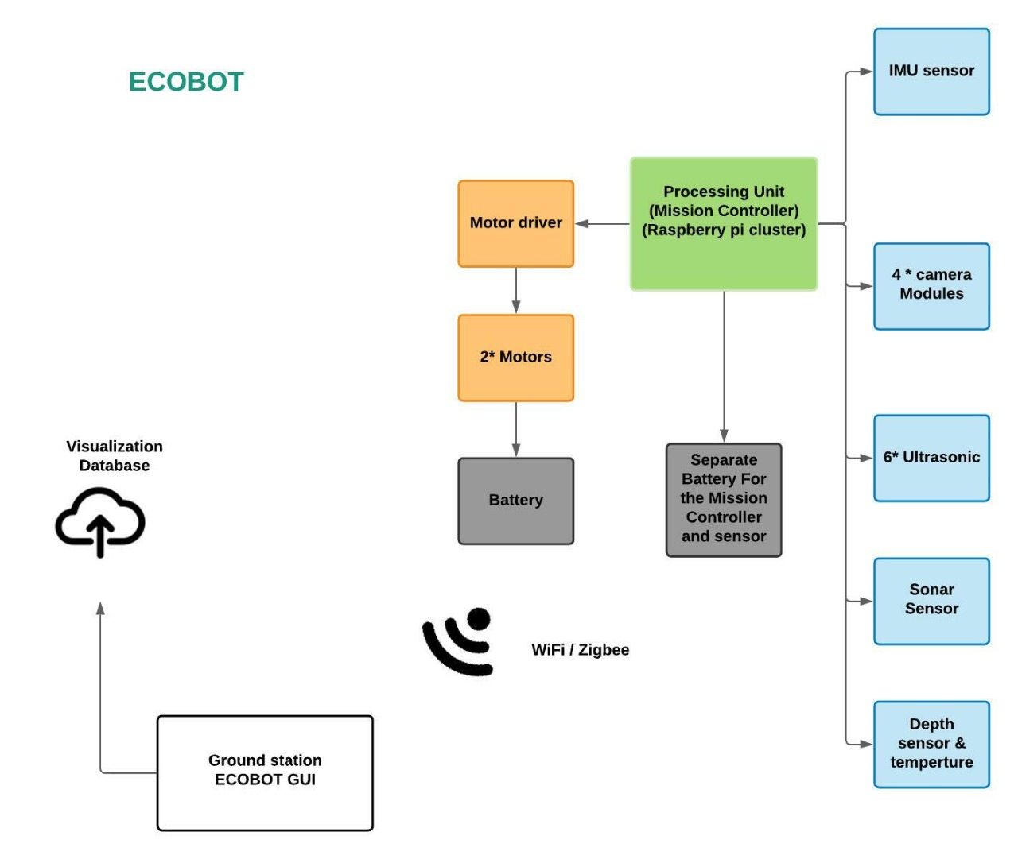
MODEL

Slide 5
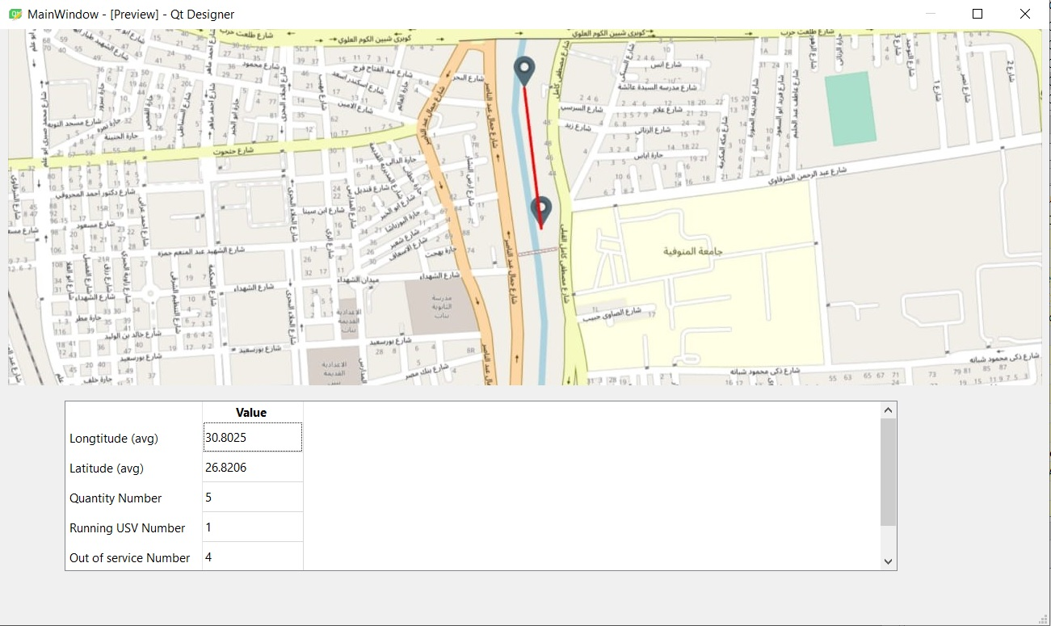
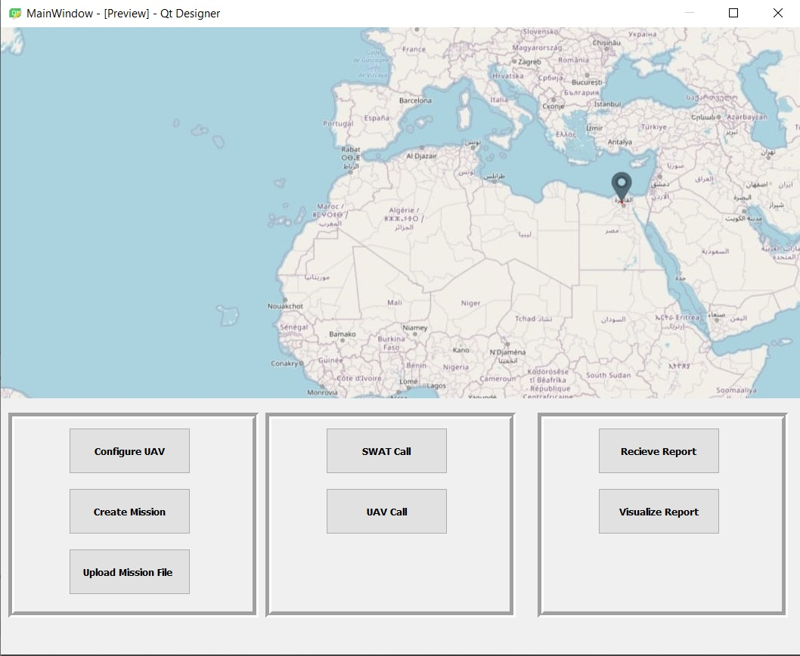
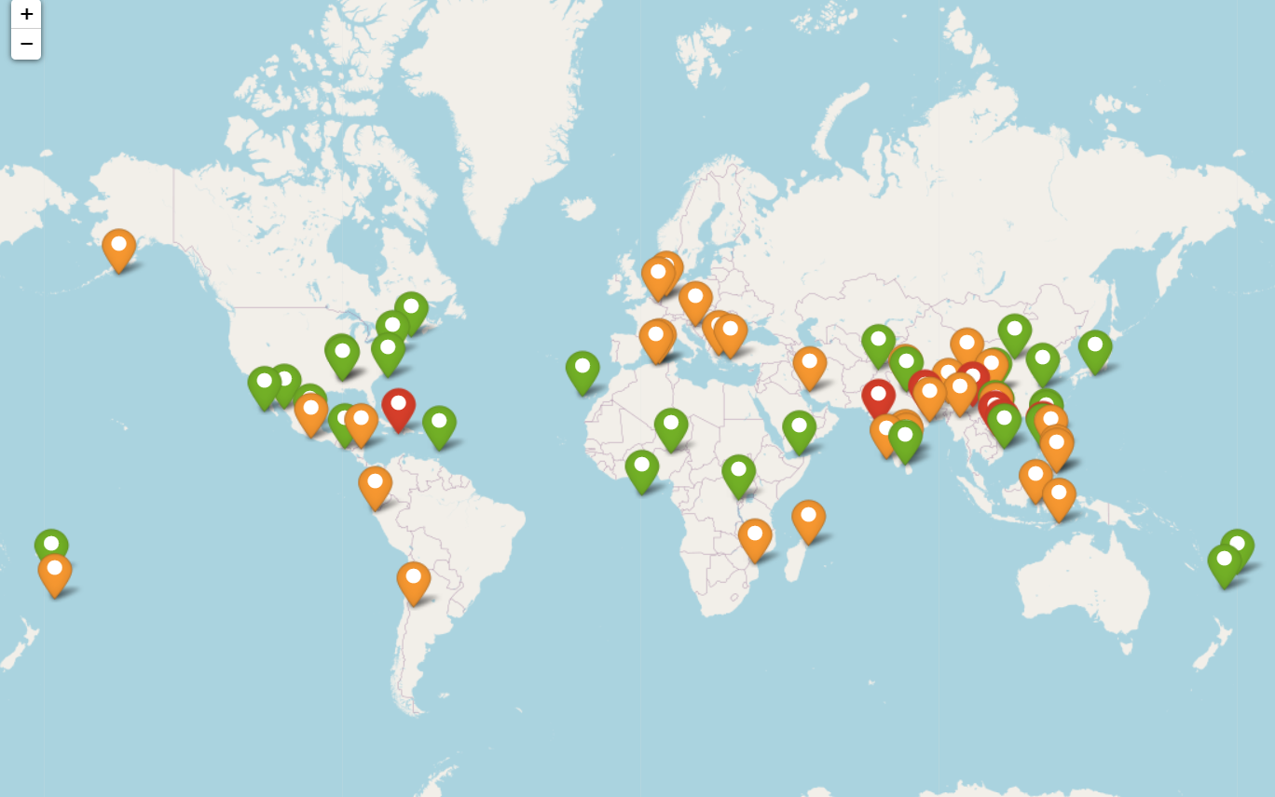
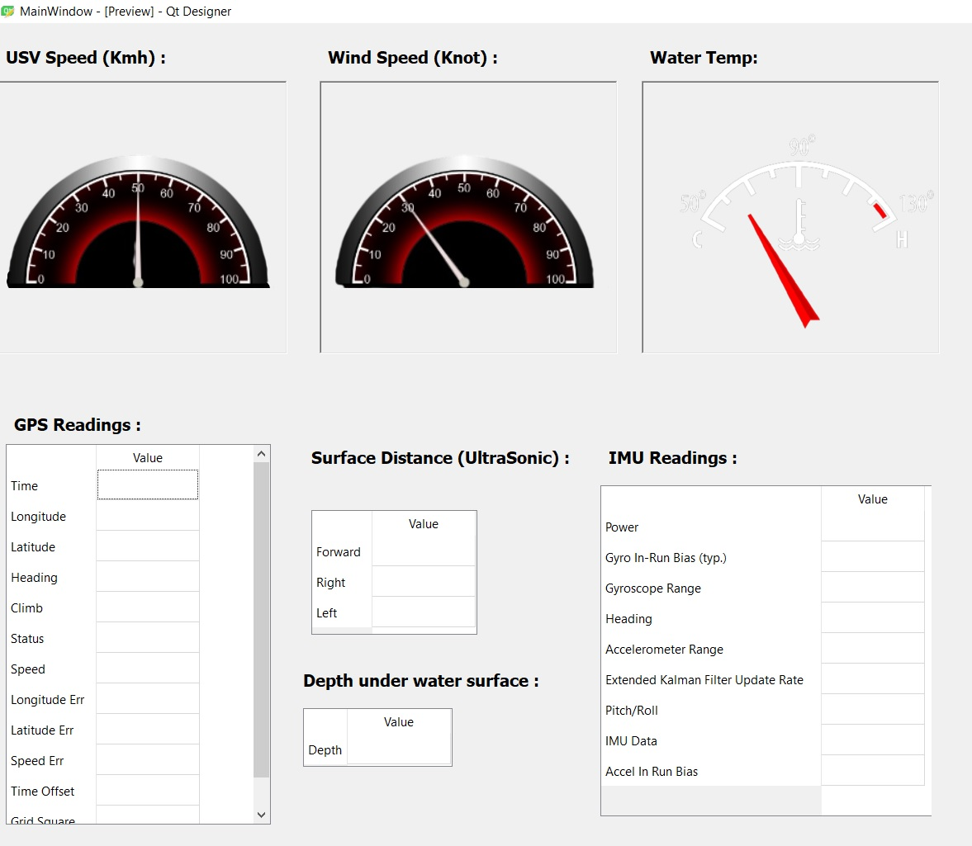
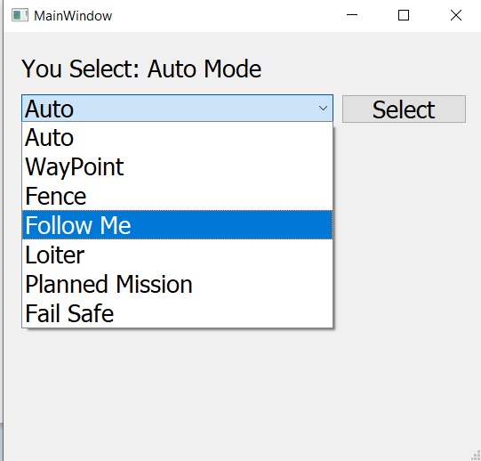
Tracking map
Swat screen
GUI
Disaster map
Sensor reading
Select mode screen

Slide 6
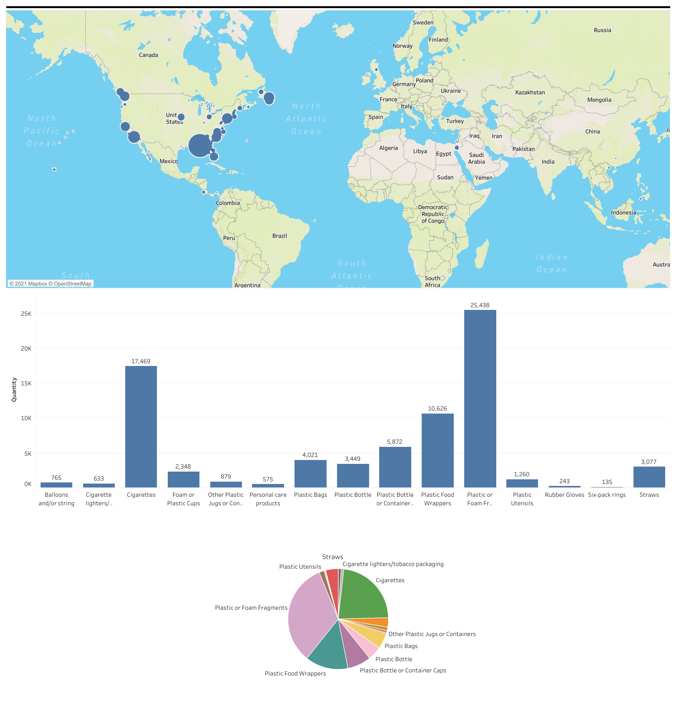
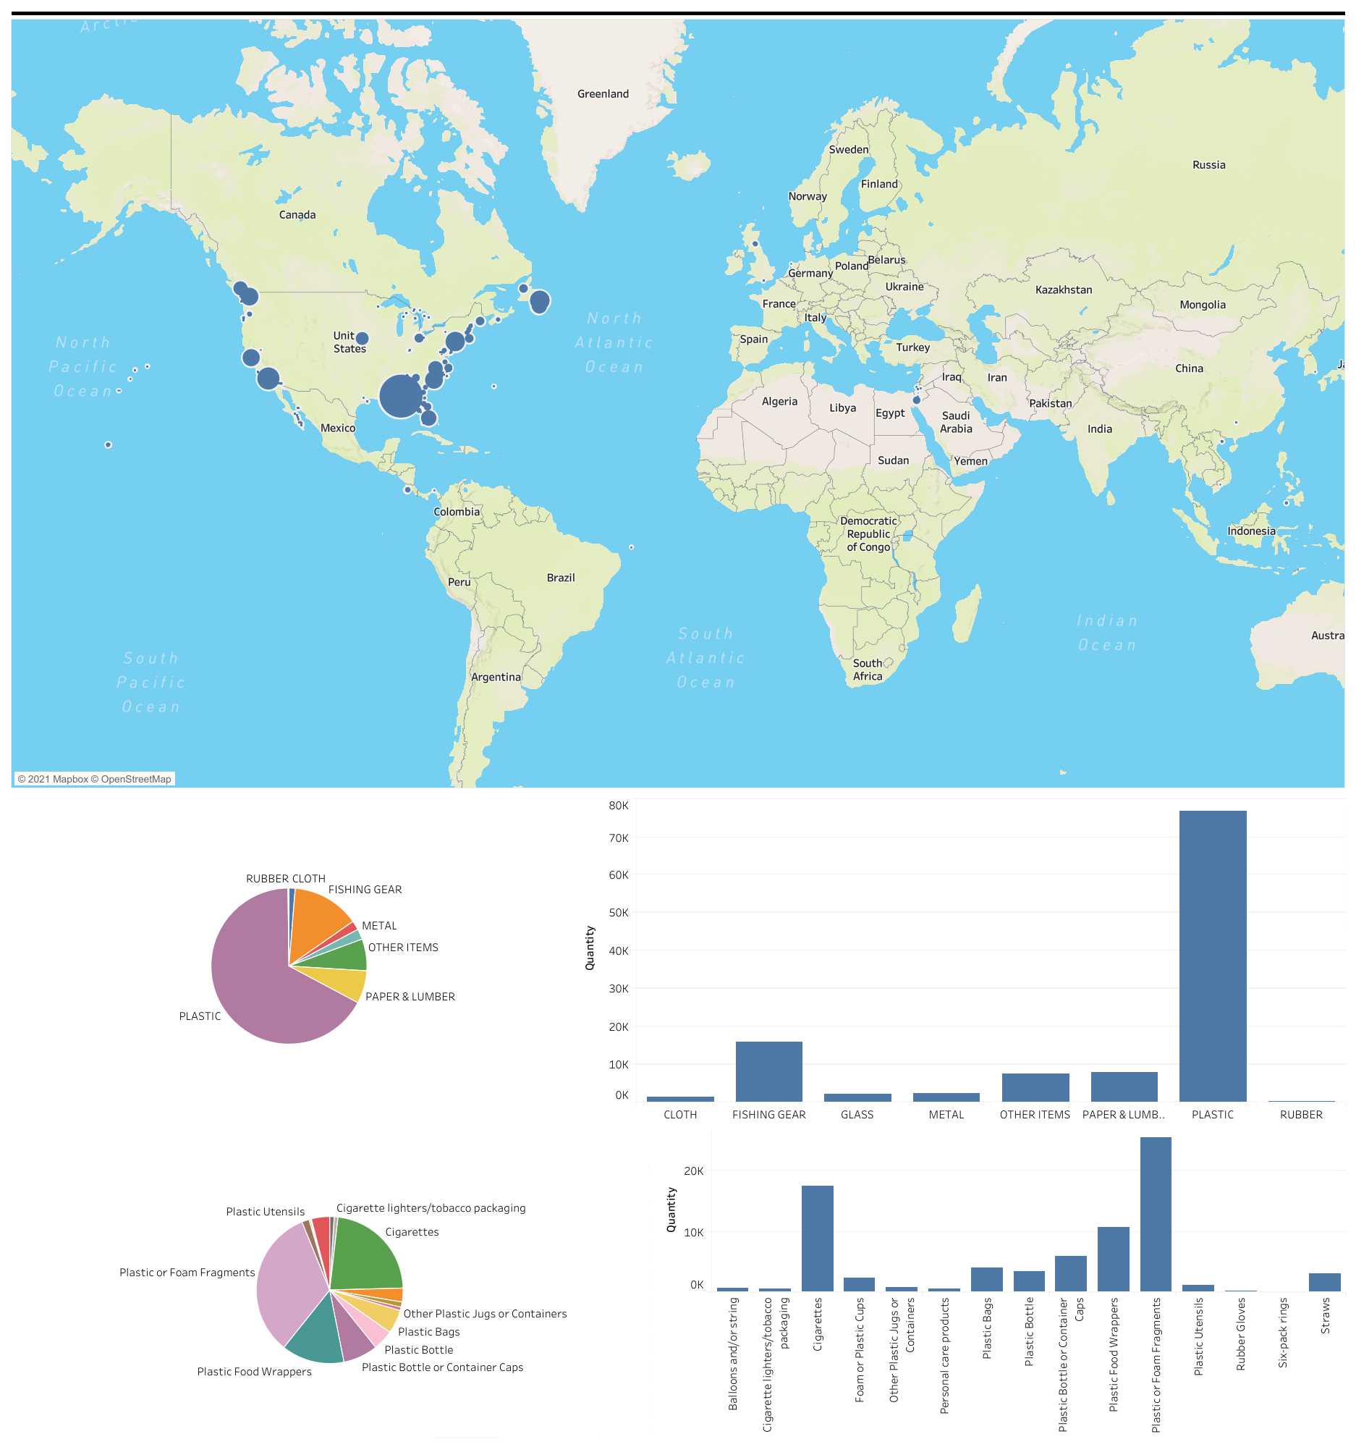
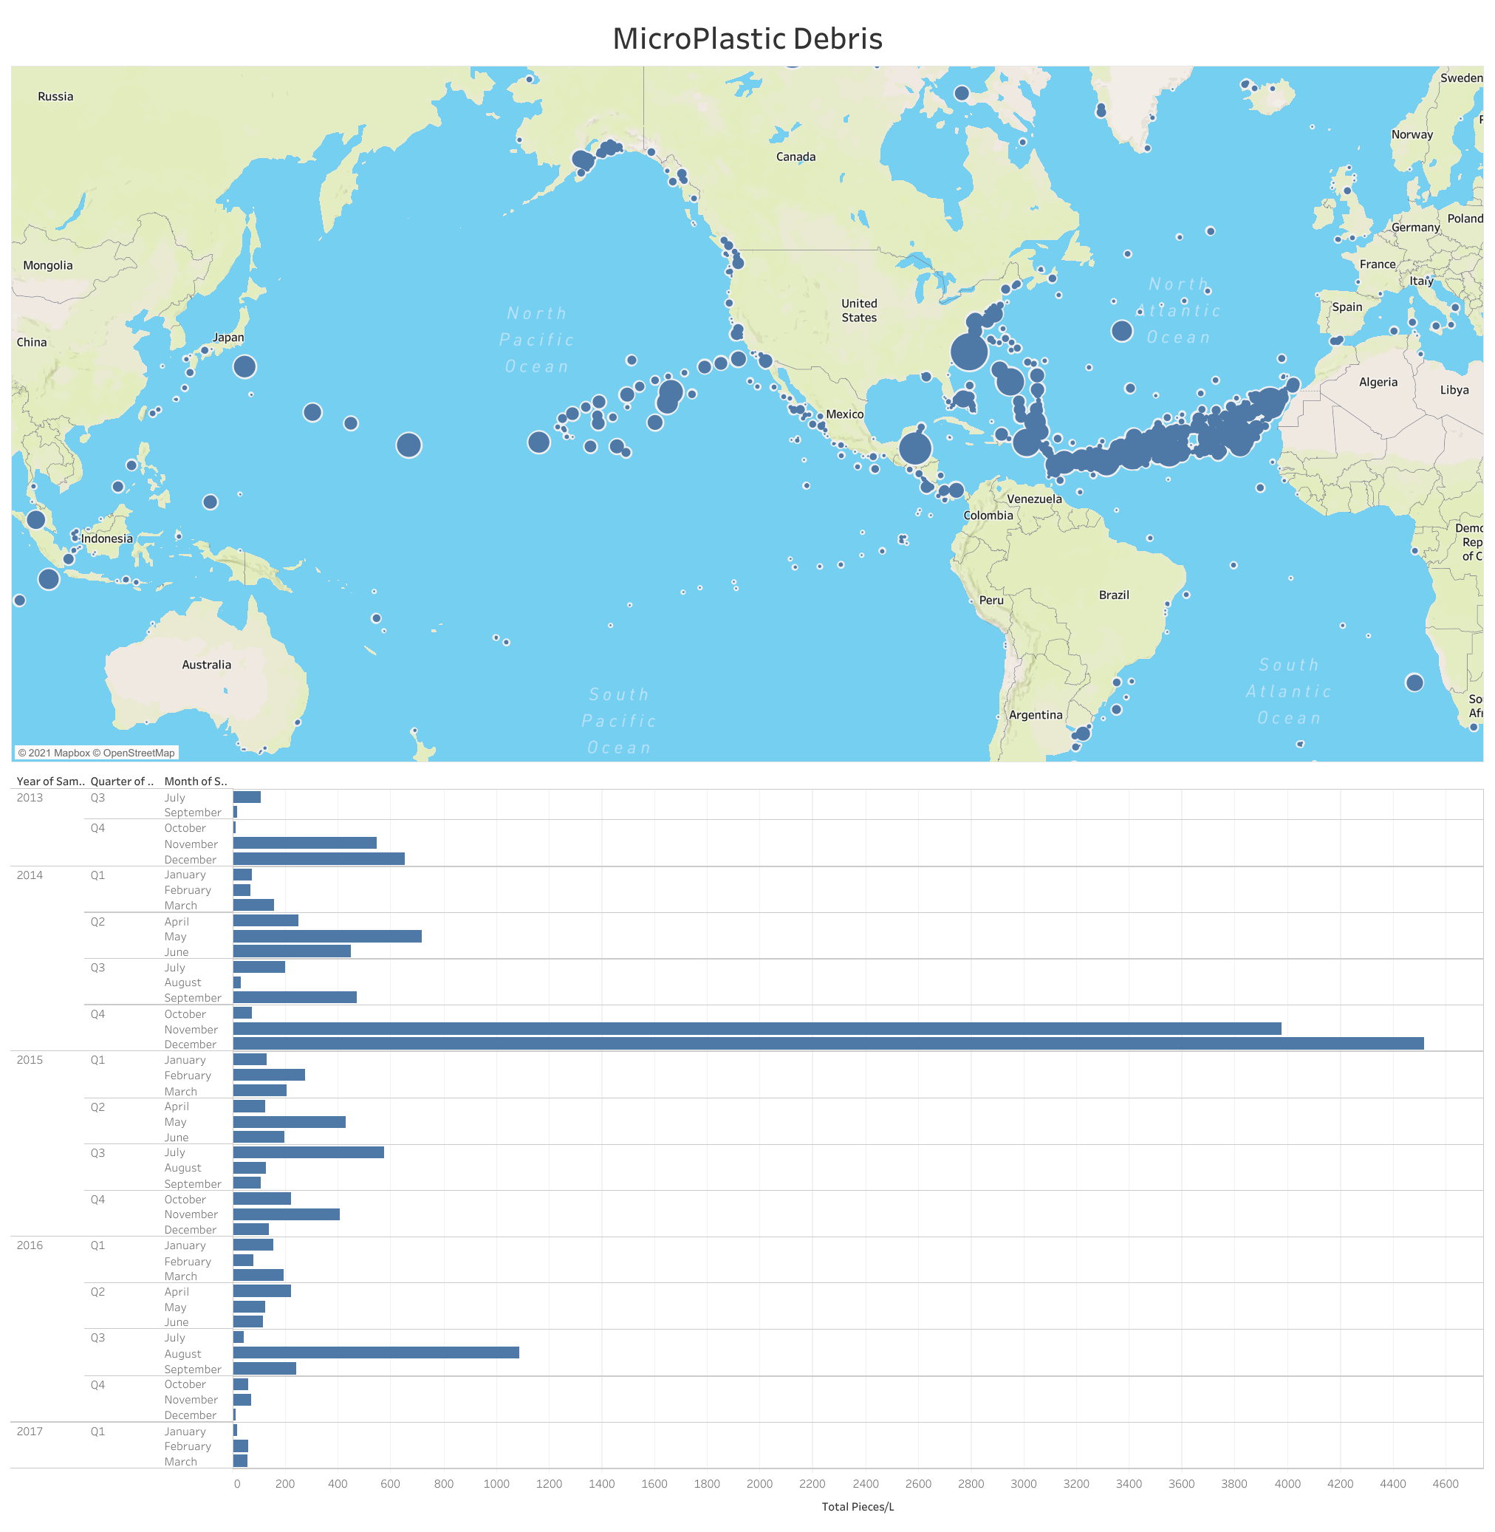
Plastic debris
All Plastic debris
VISUALIZATION
Microplastic debris

Slide 7
Future features
resources
GitHub link :
https://github.com/MostafaBoshta/EcoBot
Our site link:
https://sites.google.com/view/ecobot-gui/home

